Slide 1



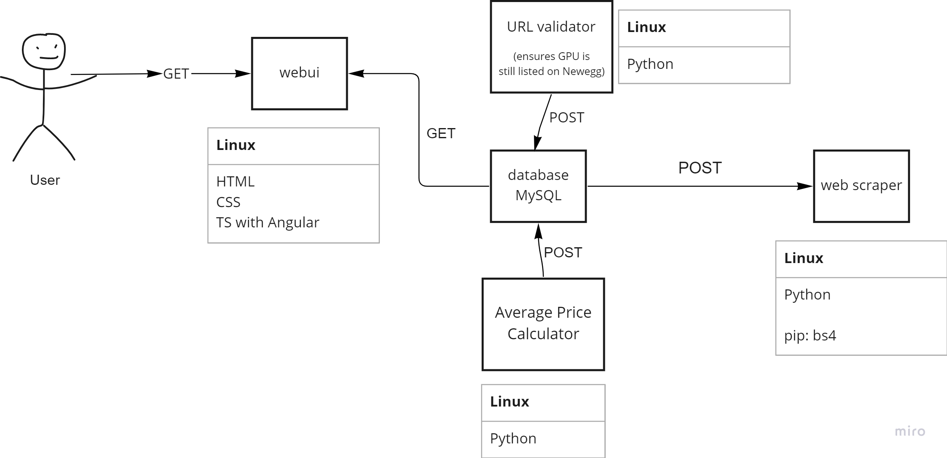

User-Interfaced Price Checker
By: Dylan Aegbuniwe, Justin Baksi, Justin Ching,
Shaun Derstine, Shepherd Shenjere
https://github.com/jubakhub/Group-1
OBJECTIVE
Create easy-to-use, centralized website for searching and wish-listing items found on Newegg.com
Offer account creation to wish-list items
Receive notifications if saved items are on sale or price decreased
Low-maintenance web scraper
Can be expanded to capture other websites
Utilize cloud-hosting to store and provide real-time updates on Newegg prices
DESIGN
Docker + Kubernetes deployment and automation of WebUI, web scraper, and database for real-time updates of item prices
WebUI developed with Angular and TypeScript
Web scraper built using PyPI Beautiful Soup Python package
Database utilizes MySQL, and when combined with cloud-infrastructure, can allow for scalability
URL validation to check if the item is still listed
Average Price Calculator that can show average price fluctuation over a determined time period
OBSTACLES
No prior experience with cloud deployment
Limited experience in web development
Difficulty with getting core features to interact with each other correctly

